Slide 1
Critical Section Problem in OS

Slide 2
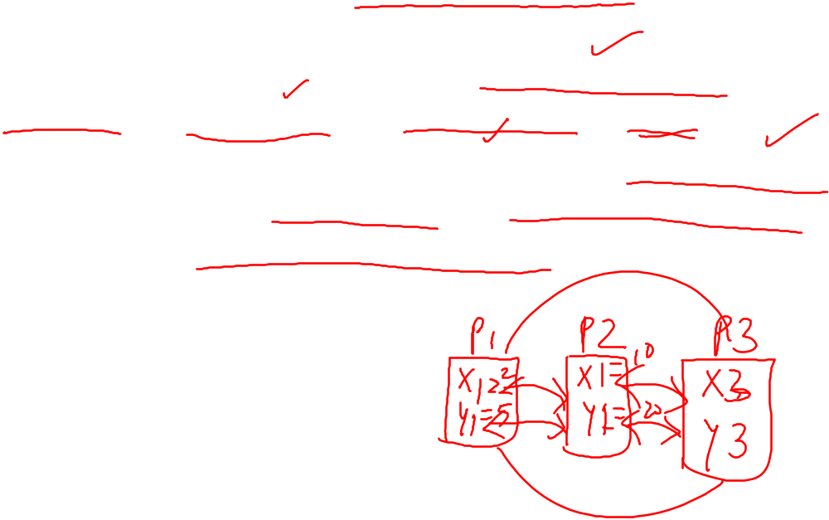
Critical Section
Consider a system consisting of n processes { P0, P1, P2,…, Pn-1}. Each process has a segment of code called a critical section.
In this section the process may be changing common variables, updating a table, writing a file and so on.
The important feature of the system is that, when one process is executing in it’s critical section, no other process is to be allowed to execute in it’s critical section.
That means no two processes are executing in their critical section at the same time.

Slide 3
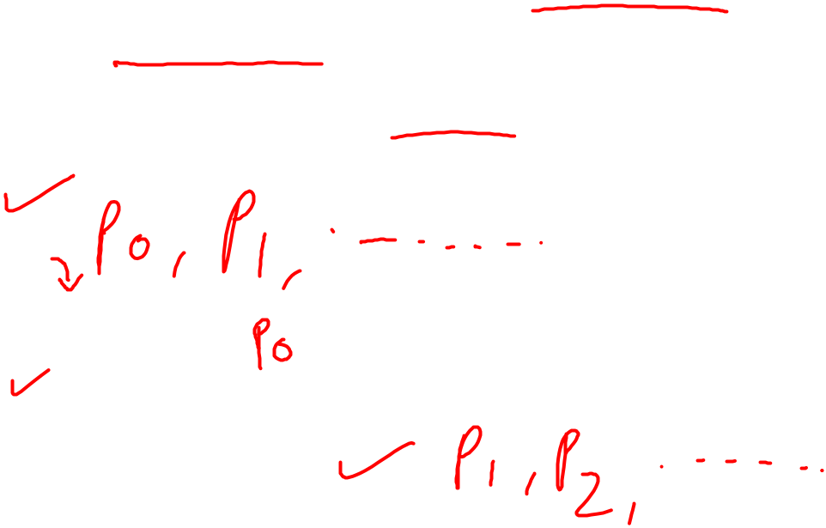
Critical Section
The critical section problem is to design a protocol that the processes can use to cooperate.
There are four sections in critical section problem –
do {
Entry Section
Critical Section
Exit Section
Remainder Section
} while(True);
Each process must request permission to enter in it’s critical section, the section of code implementing this request is the entry section.

Slide 4
Critical Section
The critical section may be followed by an exit section.
The remaining code is the remainder section.

Slide 5

Critical Section Problem
Critical Section is the part of a program which tries to access shared resources, that may be any resource in a computer like a memory location, Data structure, CPU or any IO device.
The critical section cannot be executed by more than one process at the same time; So operating system faces the difficulties in allowing and disallowing the processes from entering the critical section.
The critical section problem is used to design a set of protocols which can ensure that the Race condition among the processes will never arise.
In order to synchronize the cooperative processes, our main task is to solve the critical section problem. We need to provide a solution in such a way that the following conditions can be satisfied.

Slide 6

Solution of Critical Section Problem
1. Mutual Exclusion
By Mutual Exclusion, we mean that if one process is executing inside critical section then the other process must not enter in the critical section.
2. Progress
Progress means that if one process doesn't need to execute into critical section then it should not stop other processes to get into the critical section.
3. Bounded Waiting
We should be able to predict the waiting time for every process to get into the critical section. The process must not be endlessly waiting for getting into the critical section.

Slide 7
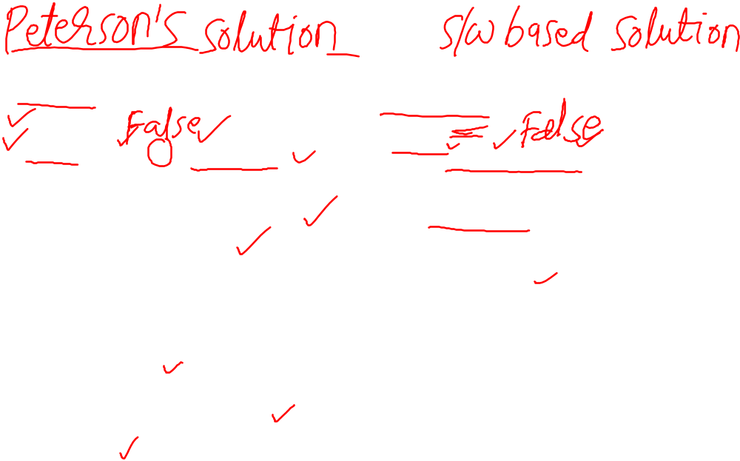
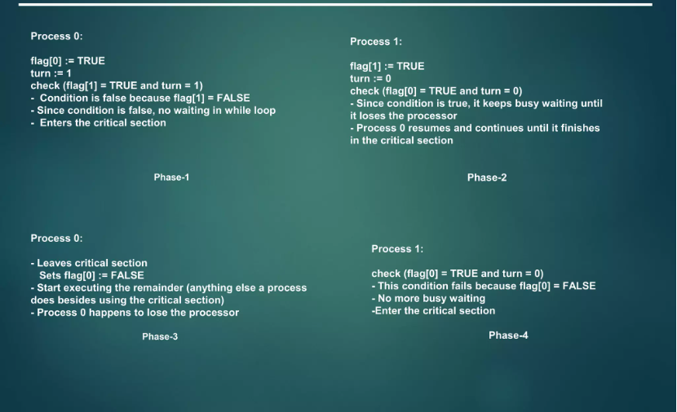

Peterson’s Solutions

Slide 8

Semaphore
Semaphores are a synchronization mechanism used to coordinate the activities of multiple processes in a computer system. They are used to enforce mutual exclusion, avoid race conditions and implement synchronization between processes.
Semaphores provide two operations: wait (P) and signal (V). The wait operation decrements the value of the semaphore, and the signal operation increments the value of the semaphore. When the value of the semaphore is zero, any process that performs a wait operation will be blocked until another process performs a signal operation.
Semaphores are used to implement critical sections, which are regions of code that must be executed by only one process at a time. By using semaphores, processes can coordinate access to shared resources, such as shared memory or I/O devices.

Slide 9

Types of Semaphore
Binary Semaphore –
This is also known as a mutex lock. It can have only two values – 0 and 1. Its value is initialized to 1. It is used to implement the solution of critical section problems with multiple processes.
Counting Semaphore –
Its value can range over an unrestricted domain. It is used to control access to a resource that has multiple instances.

Slide 10
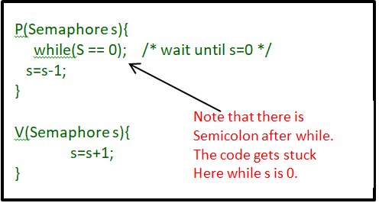

two operations that can be used to access and change the value of the semaphore variable.

Slide 11
Some points regarding P and V operations
P operation is also called wait, sleep, or down operation, and V operation is also called signal, wake-up, or up operation.
Both operations are atomic and semaphore(s) is always initialized to one. Here atomic means that variable on which read, modify and update happens at the same time/moment with no pre-emption i.e. in-between read, modify and update no other operation is performed that may change the variable.
A critical section is surrounded by both operations to implement process synchronization. See the below image. The critical section of Process P is in between P and V operation.

Slide 12
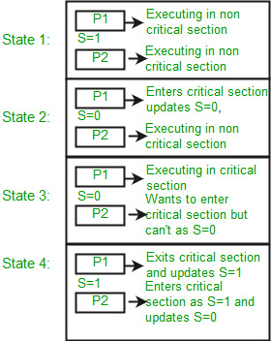
Let there be two processes P1 and P2 and a semaphore s is initialized as 1. Now if suppose P1 enters in its critical section then the value of semaphore s becomes 0. Now if P2 wants to enter its critical section then it will wait until s > 0, this can only happen when P1 finishes its critical section and calls V operation on semaphore s.

Slide 13
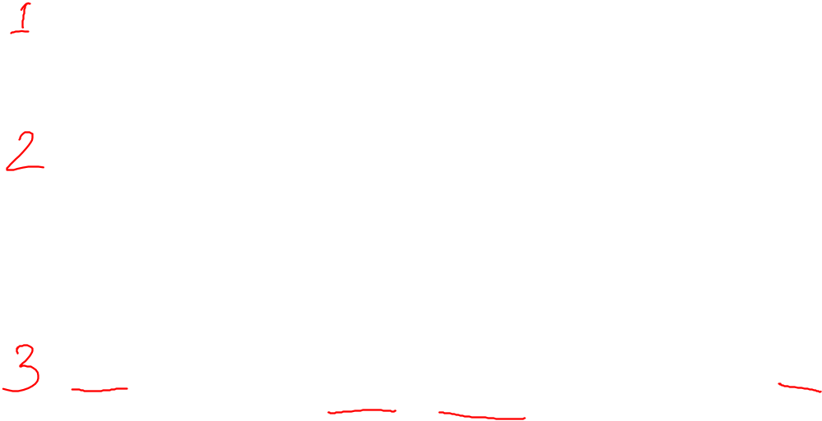
Difference between critical section, Semaphore and Mutex
A critical section in which the process may be changing common variables, updating table, writing a file and perform another function. The important problem is that if one process is executing in its critical section, no other process is to be allowed to execute in its critical section. Each process much request permission to enter its critical section.
A semaphore is a tool for synchronization and it is used to remove the critical section problem which is that no two processes can run simultaneously together so to remove this two signal operations are used named as wait and signal which is used to remove the mutual exclusion of the critical section. as an unsigned one of the most important synchronization primitives, because you can build many other Decrementing the semaphore is called acquiring or locking it, incrementing is called releasing or unlocking.
A mutex is a special case of the semaphore and also known as binary mutex it can have only two values minimum of 0 and maximum of 1, meaning it can be either locked or unlocked. It is used to prevent more than one thread from accessing the same data while allowing multiple threads to run on it.

